Slide 1
An IMS-based IPTV Network
Group Members
Yuri Kolesnikov
Nishant Karajgikar
Nikhil G. Khatu

Slide 2
Introduction
Alternative implementations of IPtV
Why IMS-based IPTV?
Results, contributions, benefits

Slide 3
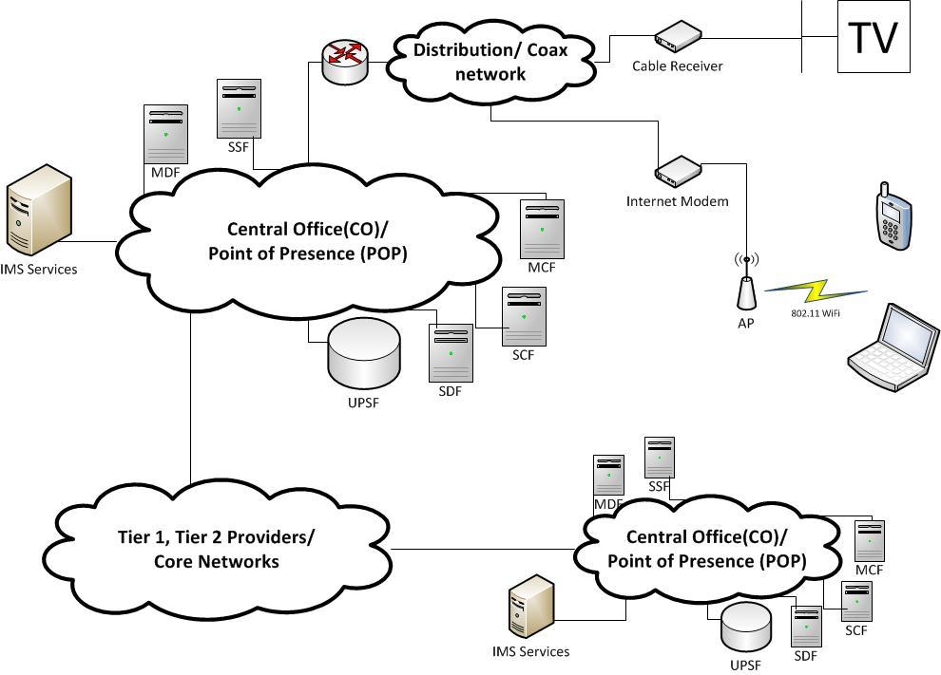
Generic View of an IPTV network

Slide 4
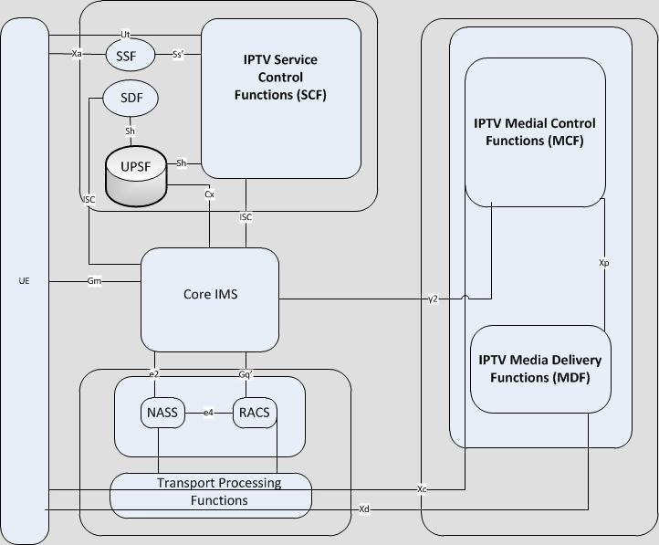
Design Inspiration

Slide 5
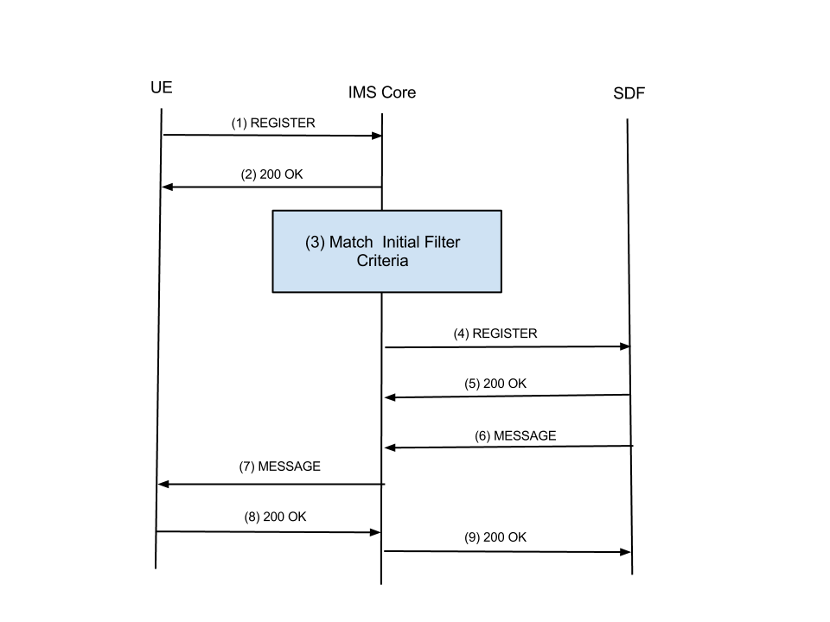
UE Service Attachment

Slide 6
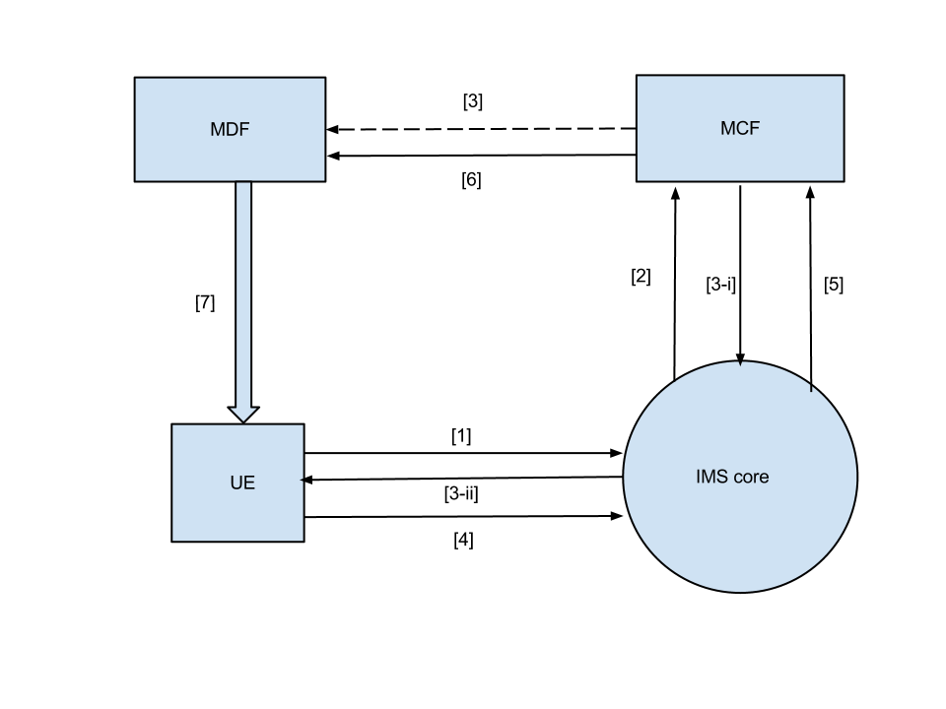
MDF to UE streaming

Slide 7
Conclusions
Summary of results:
Set up of a functional IPTV network
Afforded user basic control over stream
Incorporated more advanced features of channel switching, skipping, pause and play mechanisms
Future plans:
Developed framework allows for a great deal of innovation
Due to the stability of the basic framework adding functionality would be easy to implement
Possibilities for mashups

Slide 8
References
1) ETSI TS 182 027
2) Networking Services - QOS, Signalling, Processes - Dr. Harry Perros
3) Interactive, Personalized IPTV - Ignacio Más and Viktor Berggren, Ericsson Research.Rittwik Jana, John Murray, and Christopher W. Rice, AT&T Labs Research
4) IMS based IPTV services - Architecture and Implementation - Eugen Mikoczy, Dmitry Sivchenko, Bangnan Xu, Veselin Rakocevic

